Slide 1
Folgeerkrankungen nach einer
Tuberkulose
Hans L Rieder
Bern, IFIK, 28. März 2019

Slide 2
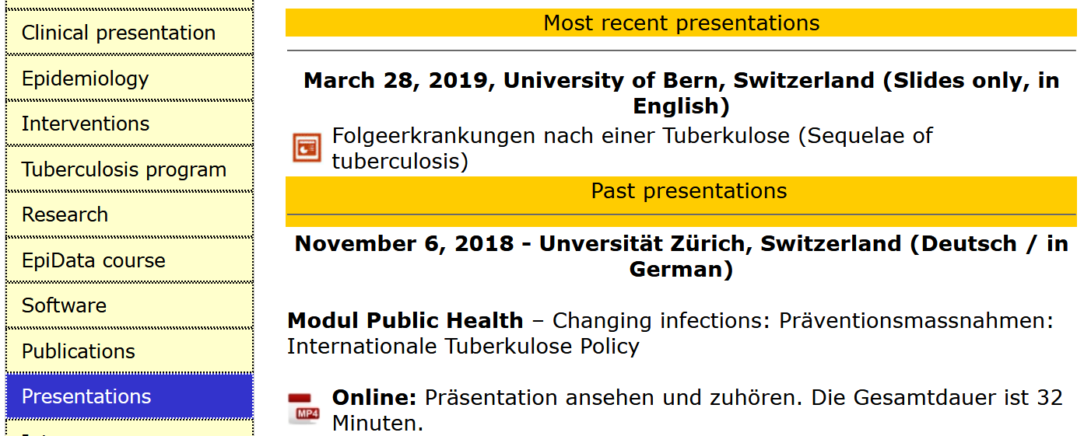
Access
Web site: | https://www.tbrieder.org
Page | Presentations

Slide 3
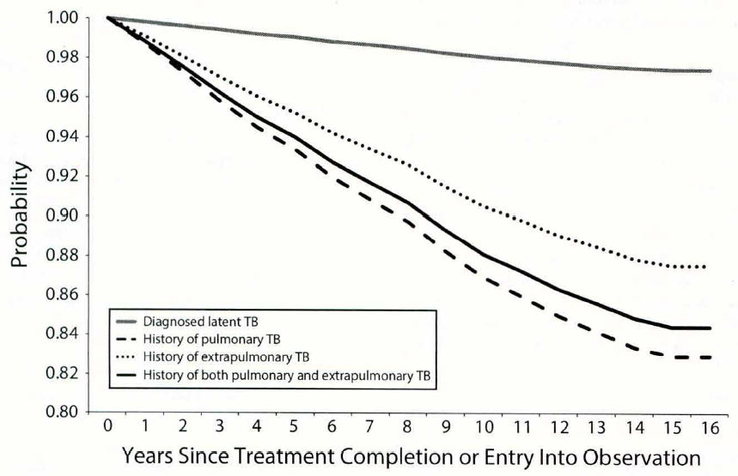
Survival probability among 4,000 tuberculosis
patients during follow-up in the United States
Control group:
latent infection
After extrapulmonary
tuberculosis
After pulmonary
tuberculosis
Miller T L, et al. Am J Public Health 2015;105:930-1

Slide 4
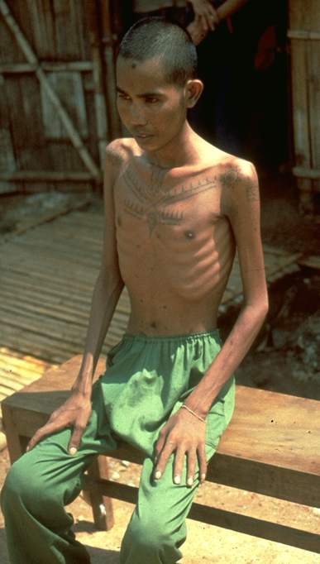
Pulmonary, osteoarticular (spine) and genitourinary tuberculosis
[Note hypertrophic osteoarthropathy]
Thai / Swiss Red Cross TB Programme for Cambodian refugees, Khao-I-Dang Holding Centre, Prachinburi, Thailand, 1981-1984, unpublished

Slide 5
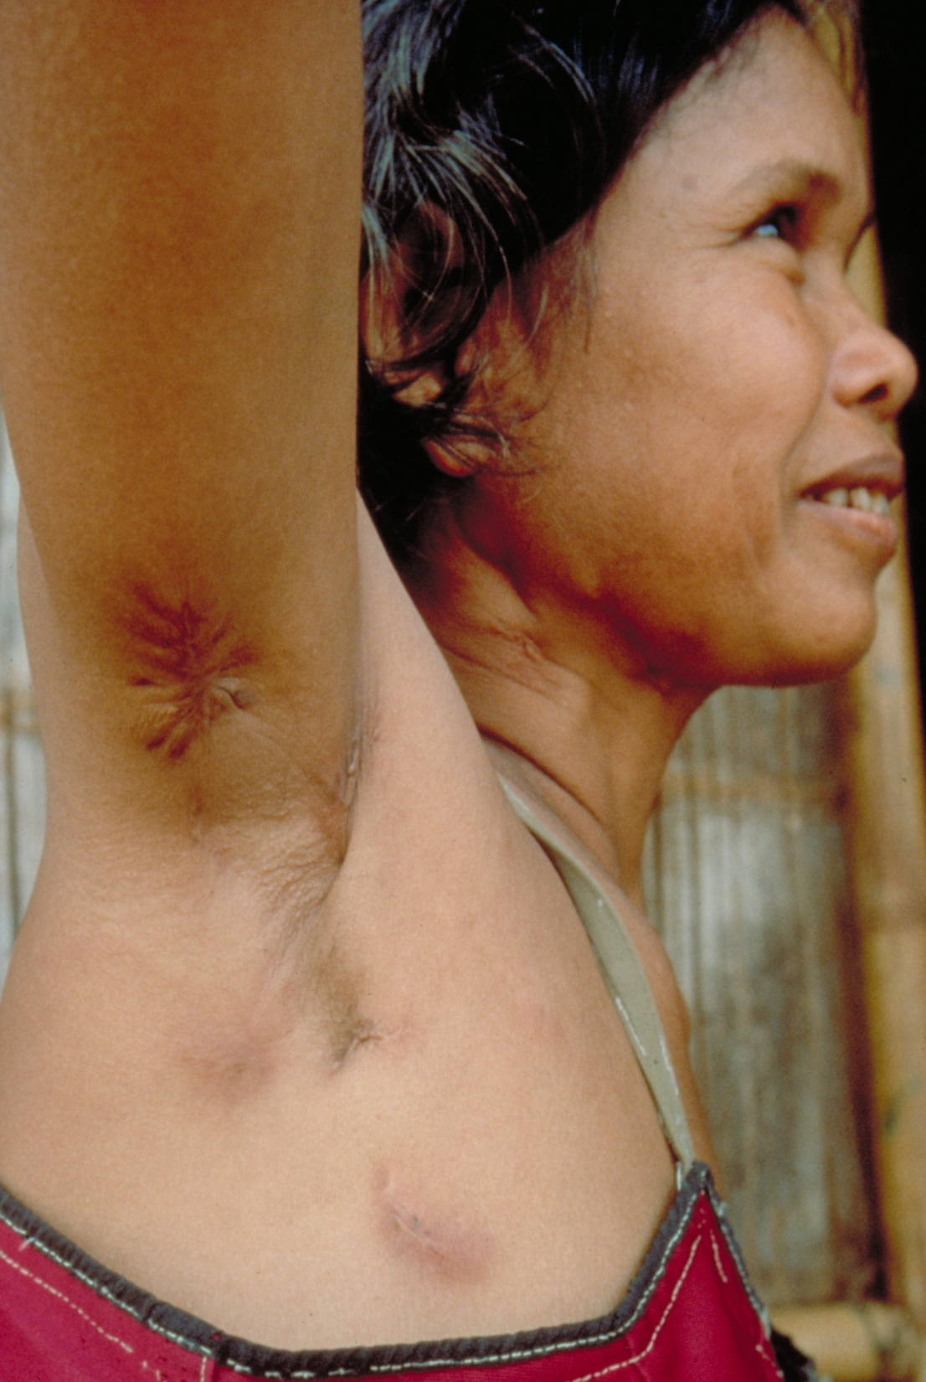
A 7-year history of recurring peripheral lymphatic tuberculosis (still active), leaving extensive scarring
Thai / Swiss Red Cross TB Programme for Cambodian refugees, Khao-I-Dang Holding Centre, Prachinburi, Thailand, 1981-1984, unpublished

Slide 6
Examples selected for illustration
o | Tuberculous meningitis
o | Disseminated, miliary-like tuberculosis
o | Osteoarticular tuberculosis
o | Pulmonary tuberculosis

Slide 7
Tuberculous meningitis

Slide 8
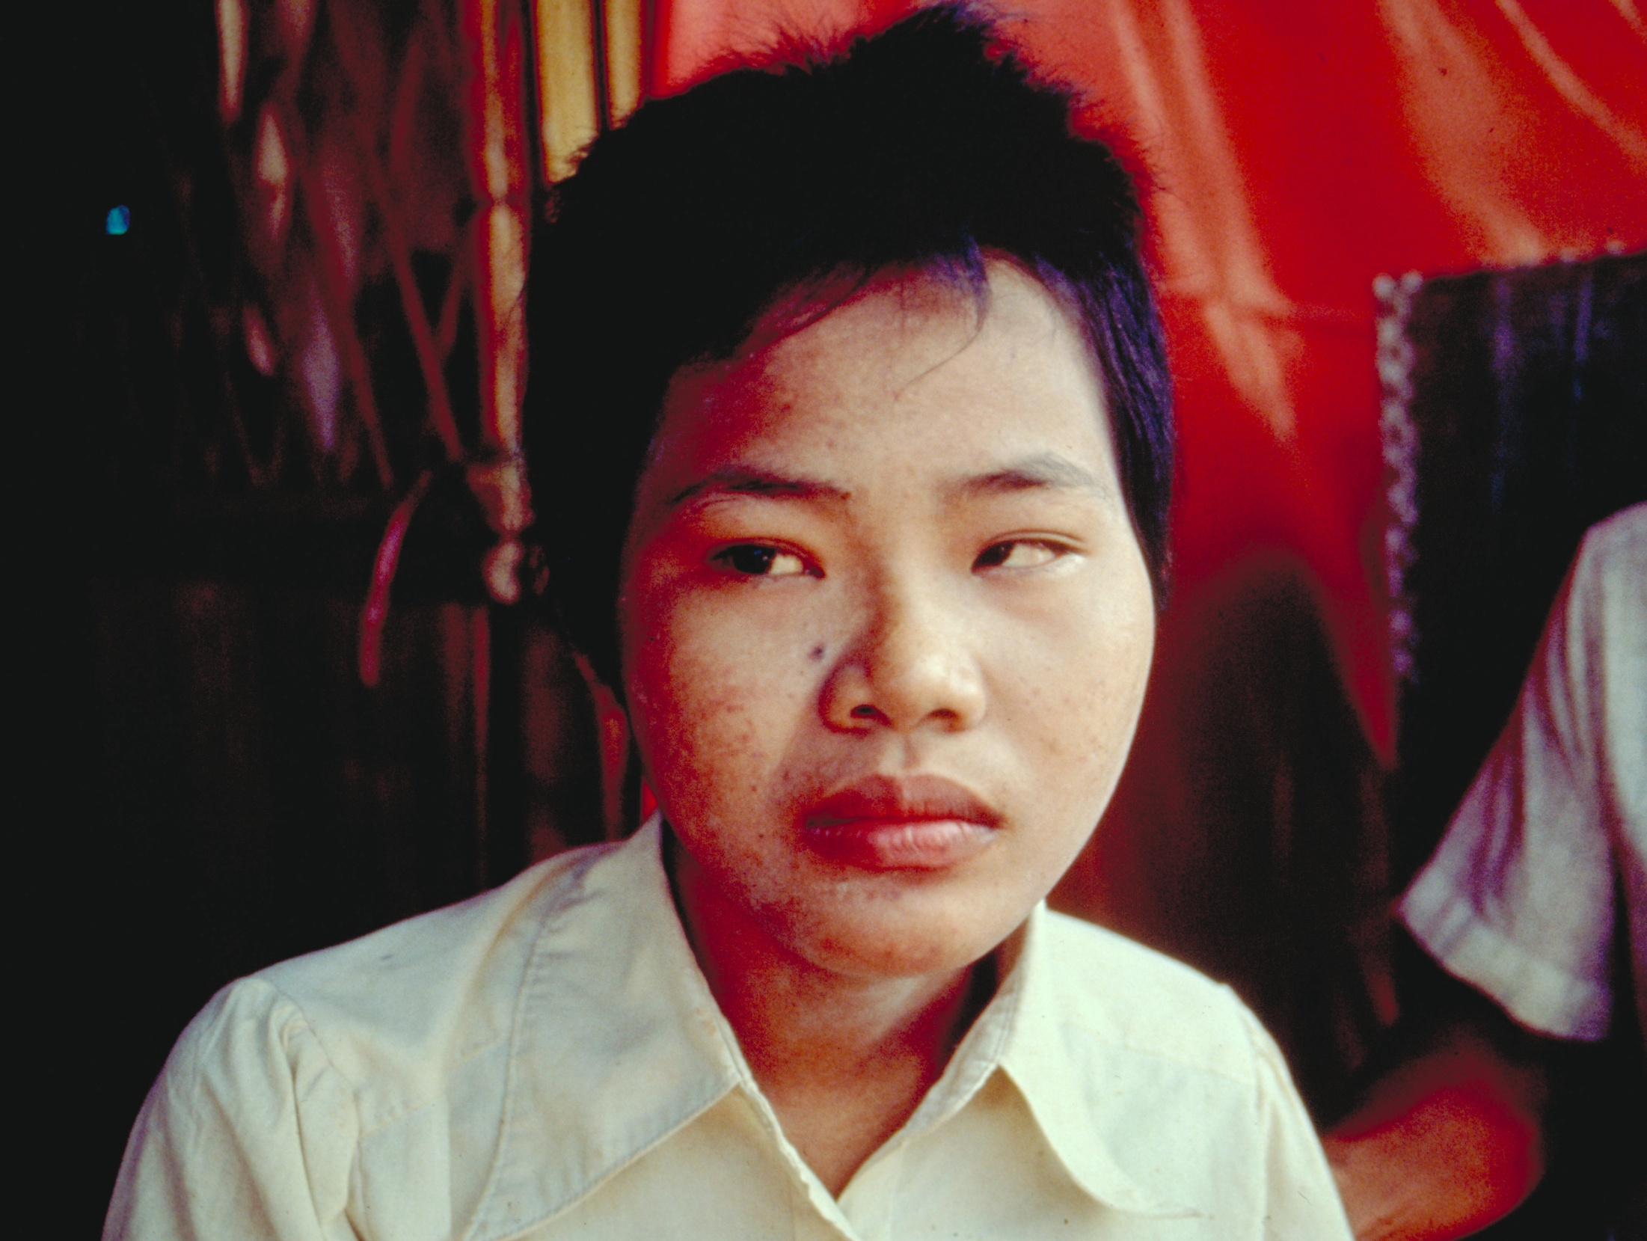
Tuberculous
meningitis with
N abducens
palsy, left
Thai / Swiss Red Cross TB Programme for Cambodian refugees, Khao-I-Dang Holding Centre, Prachinburi, Thailand, 1981-1984, unpublished

Slide 9
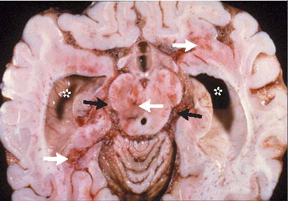
Hydrocephalus in tuberculous meningitis
Donald PR, et al. N Engl J Med 2004;351:1719-20
Teaching-aids At Low Cost, http://www.talcuk.org/about.htm

Slide 10
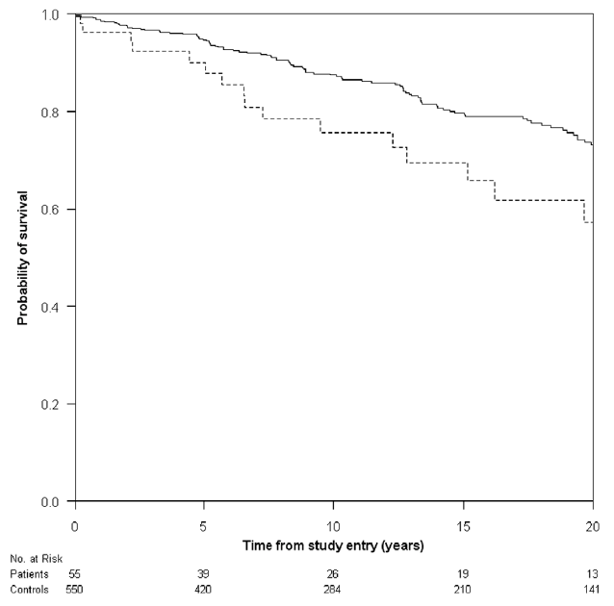
Long-term survival after tuberculous meningitis,
Denmark, 1972-2008
Population control
Tuberculous meningitis
Halkjær Christensen A S, et al. PLoS ONE 2011;6:e27900

Slide 11
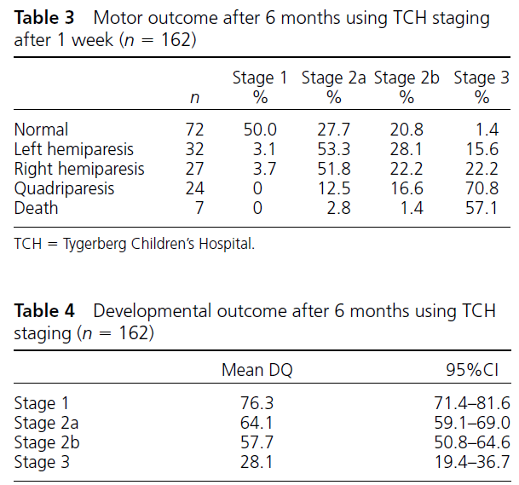
Outcome of tuberculous meningitis by stage at diagnosis, South Africa
van Toorn R, et al. Int J Tuberc Lung Dis 2012;16:628-32

Slide 12
Miliary tuberculosis

Slide 13
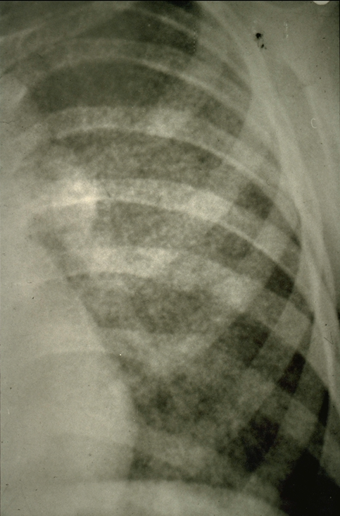
Miliary tuberculosis with hilar lymphadeno-pathy in a child
Thai / Swiss Red Cross TB Programme for Cambodian refugees, Khao-I-Dang Holding Centre, Prachinburi, Thailand, 1981-1984, unpublished

Slide 14
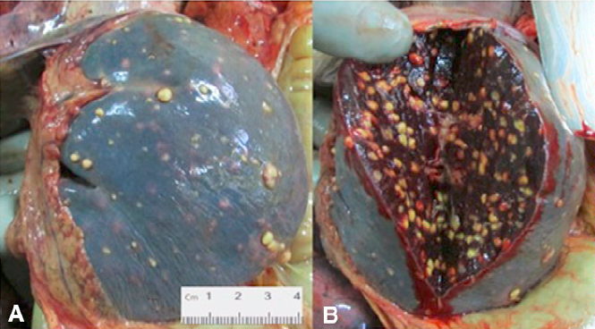
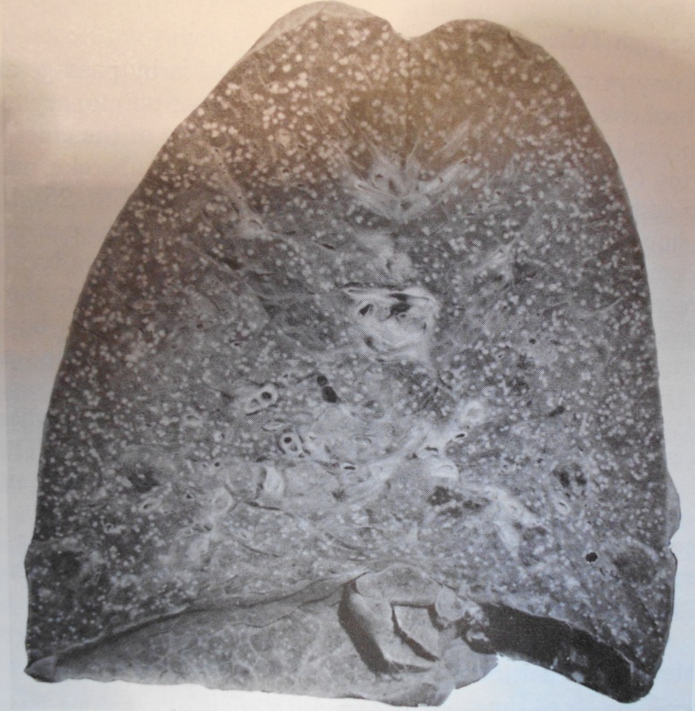
‘Pomegranade’ spleen
García-Basteiro A L, et al.
Am J Respir Crit Care Med
2015;192:387-8
Lungs
Florey H. General Patholgy (3rd ed)
Lloyd-Luke Ltd, London 1964;p 1012

Slide 15
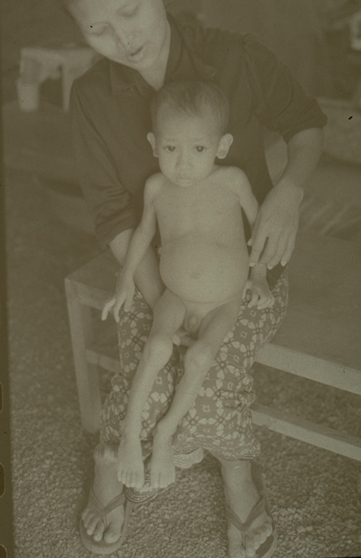
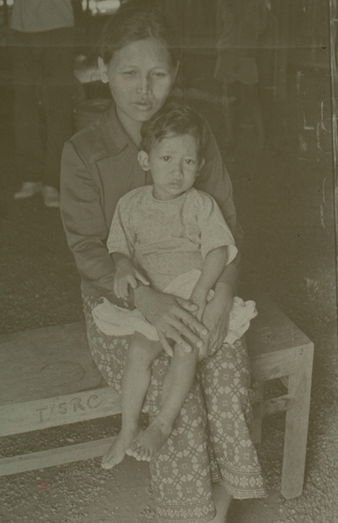
Thai / Swiss Red Cross TB Programme for Cam-
bodian refugees, Khao-I-Dang Holding Centre, Prachinburi, Thailand, 1981-1984, unpublished
After two months chemotherapy
After six months chemotherapy

Slide 16
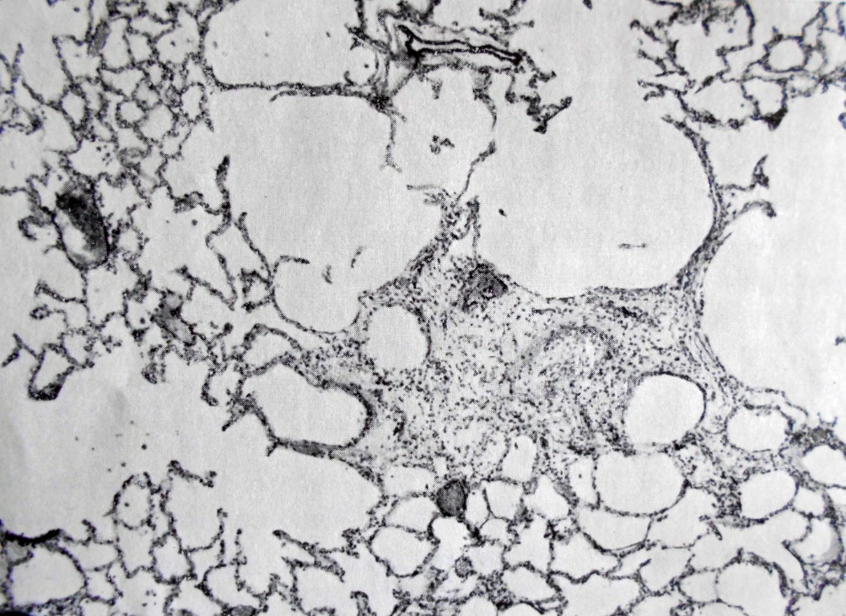
End-of-treatment regression of miliary tuberculosis
with star-like scarring and perinodular emphysema
=> Restrictive and obstructive lung disease
Uehlinger E. In: Hein J, Kleinschmidt H, Uehlinger E, eds.
Handbuch der Tuberkulose, 1964, Volume IV, pp 1-32

Slide 17
Osteoarticular tuberculosis

Slide 18
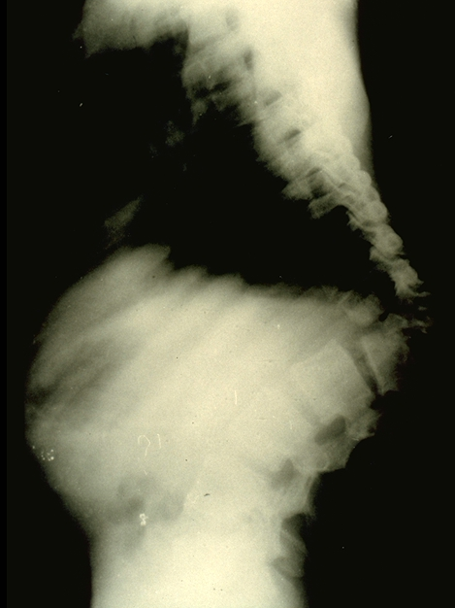
Bacteriologically healed tuberculosis of the spine without any residual myelopathy
Thai / Swiss Red Cross TB Programme for Cambodian refugees, Khao-I-Dang Holding Centre, Prachinburi, Thailand, 1981-1984, unpublished

Slide 19
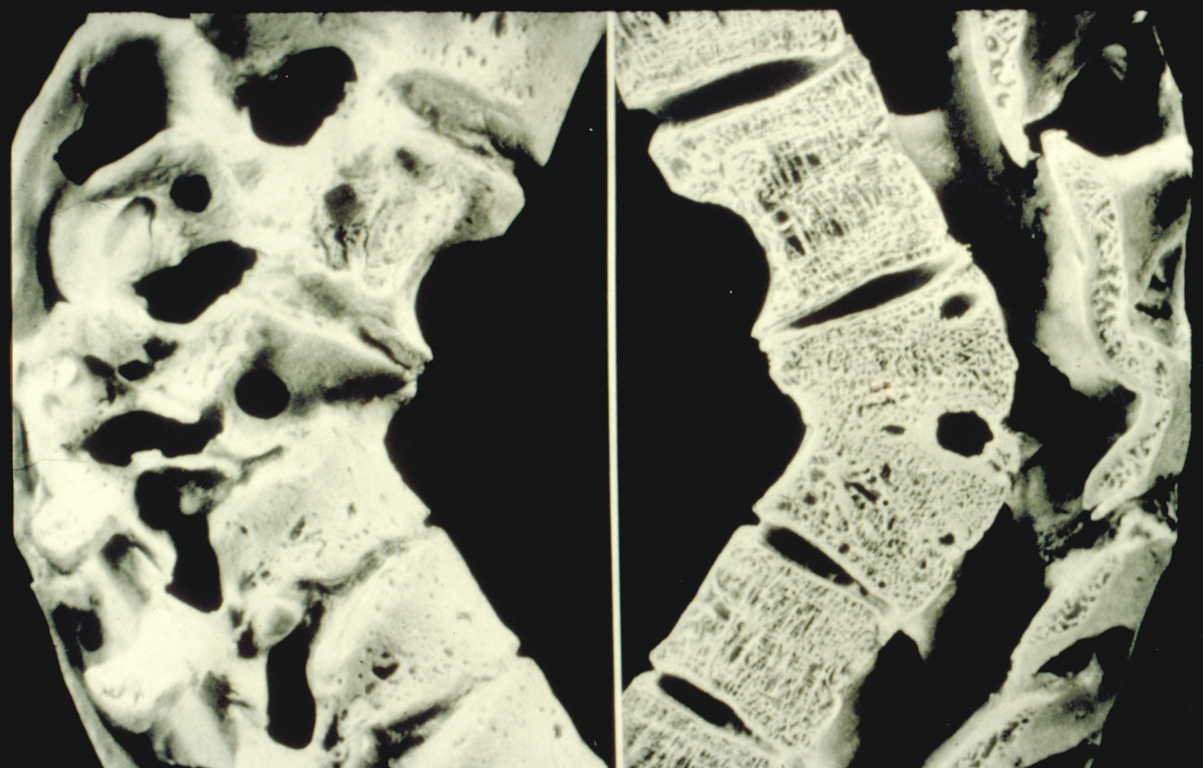
Kastert J, Uehlinger E. In: Hein J, Kleinschmidt H, Uehlinger E, eds.
Handbuch der Tuberkulose, 1964, Volume IV, p 460

Slide 21
15-year follow-up of BMRC clinical trials on tuberculosis of the spine
15-year outcome |  | Korea (all series)* | Hong Kong**
 |  |  | Radical | Débridement
Favorable |  | 87% | 87% | 87%
Doubtful |  | <1% | 0% | 0%
Unfavorable
 | Death (spinal) | 2% | 0% | 0%
 | Persistent myelopathy | 1% | 0% | 0%
 | Persistent sinus | <1% | 0% | 0%
 | Additional treatment | 9% | 13% | 13%
Death due to TB elsewhere |  | [4 cases] | [0 cases] | [0 cases]
* 3 groups (ambulatory, 6 months bedrest, plaster-of-Paris jacket); chemotherapy 18 PH, randomly assigned to additional intensive phase streptomycin or not
** Chemotherapy for all 3 SPH / 18 PH
British Medical Research Council. J Bone Joint Surg Br 1998;80-B:456-62

Slide 22
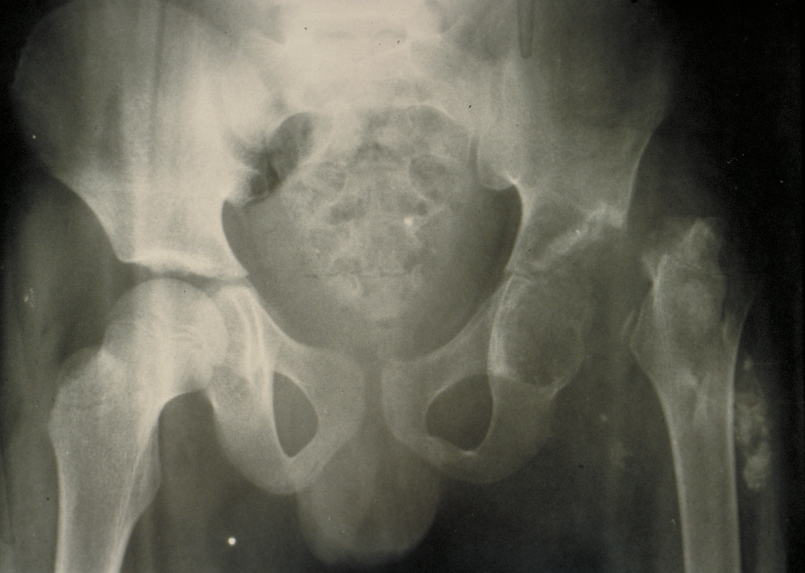
Thai / Swiss Red Cross TB Programme for Cambodian refugees, Khao-I-Dang Holding Centre, Prachinburi, Thailand, 1981-1984, unpublished

Slide 23
Pulmonary tuberculosis
Sequelae might include:
o | Obstructive pulmonary disease
 | => | Hypoxia / hypercapnia
 | => | Opportunistic superinfections (bacteria, molds)
 | => | Asthma
 | => | Pulmonary arterial hypertension / cor pulmonale
o | Restrictive pulmonary disease
 | => | Hypoxia
 | => | Pulmonary arterial hypertension / cor pulmonale
[o | Destroyed lung syndrome]

Slide 24
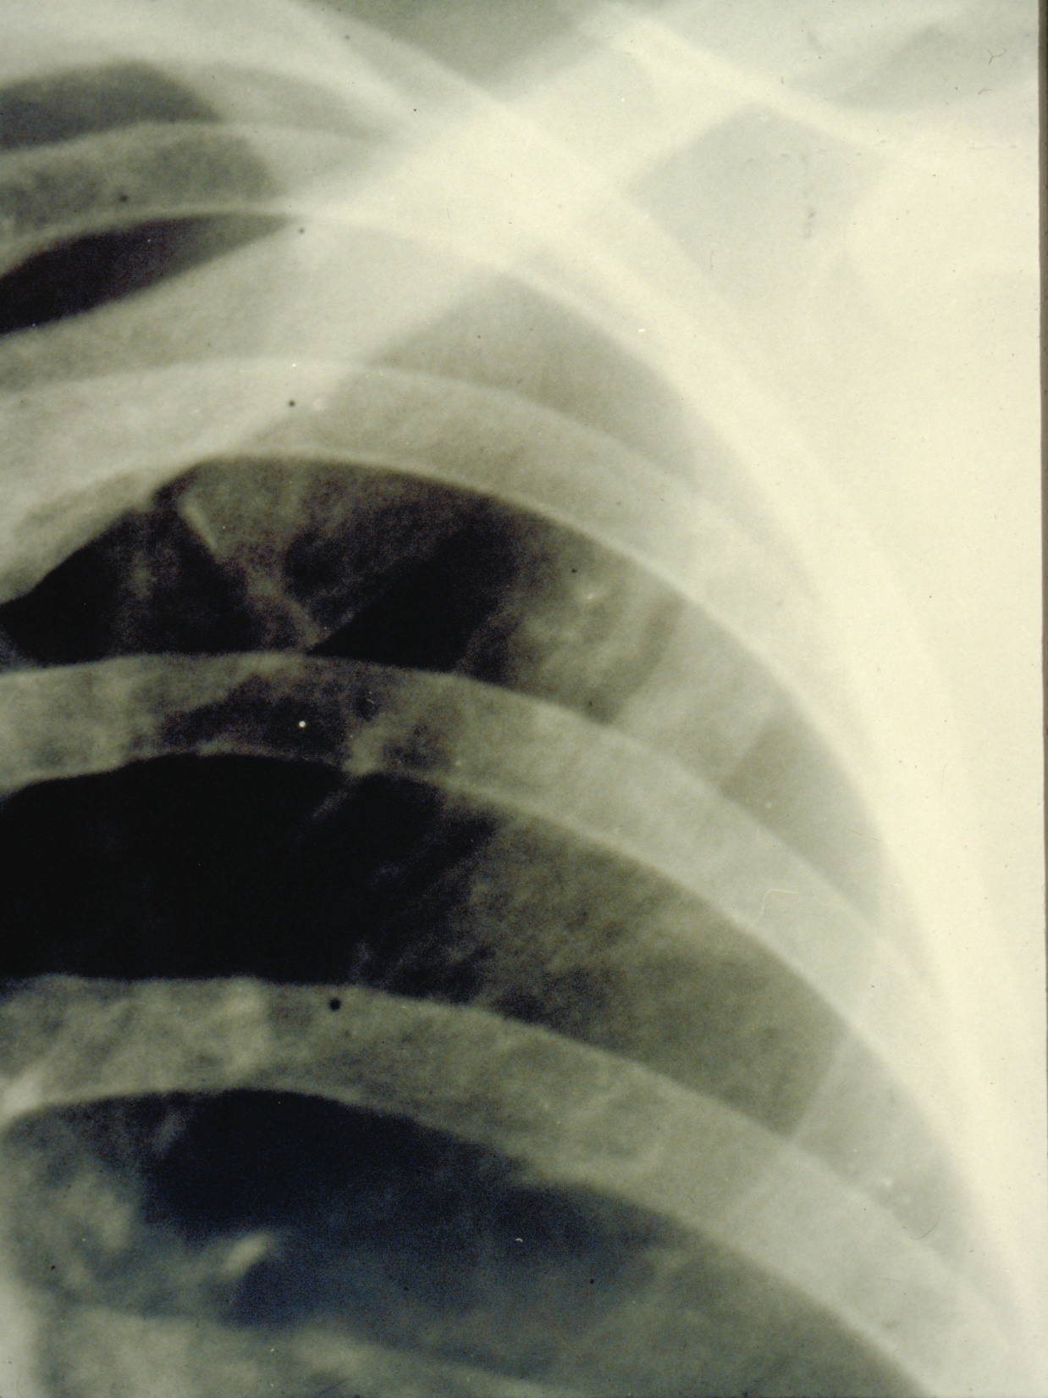
Thai / Swiss Red Cross TB Programme for Cambodian refugees, Khao-I-Dang Holding Centre, Prachinburi, Thailand, 1981-1984, unpublished

Slide 25
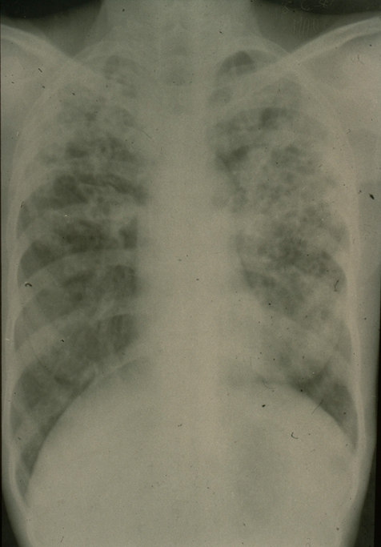
Thai / Swiss Red Cross TB Programme for Cambodian refugees, Khao-I-Dang Holding Centre, Prachinburi, Thailand, 1981-1984, unpublished

Slide 26
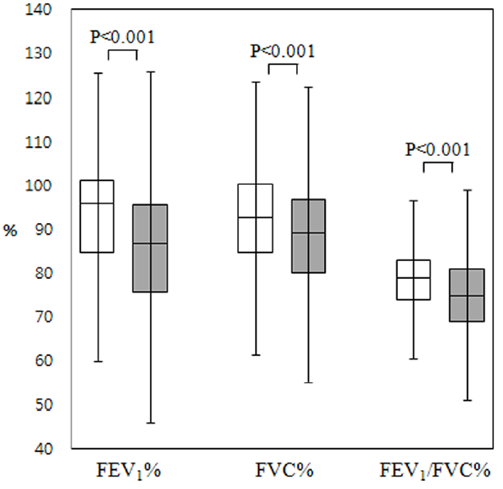

Pulmonary impairment in
tuberculosis survivors:
the Korean National Health and
Nutrition Examination Survey
2008-2012
Jung J W, et al. PLoS ONE 2015;10:e0141230

Slide 27
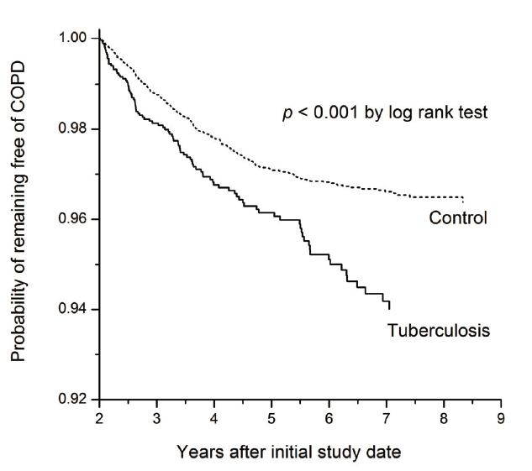
Chronic obstructive pulmonary disease after tuberculosis in Taiwan
Lee C H, et al. PLoS ONE 2012;7:e37978

Slide 28
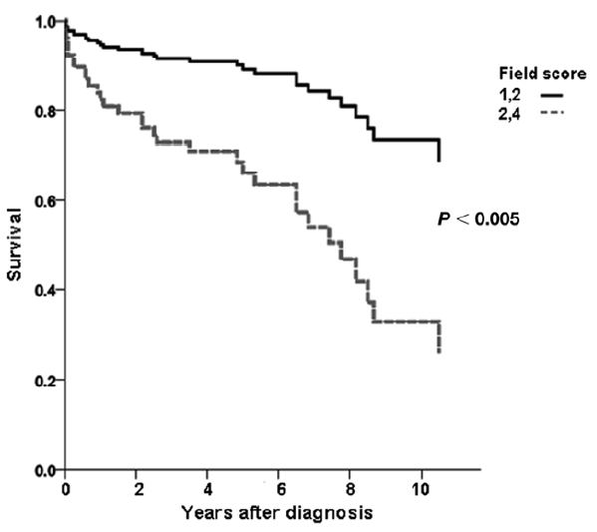
Survival probability among tuberculosis
patients with destroyed lung in Korea
Ryu Y J, et al. Int J Tuberc Lung Dis 2011;15:246-50

Slide 29
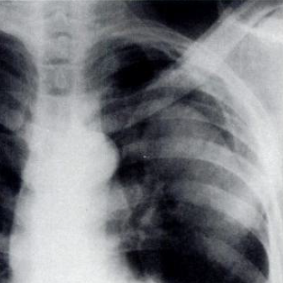
Examples of common complications
Pulmonary aspergilloma
Smith RL, et al. Chest 1987;92:948-9
Hemoptysis
Corey R, et al. Am J Med Sci 1987;294:301-9
Bronchial strictures
Watanabe YR, et al. Thorac Cardiovasc Surgeon 1988;36:27-32
Bronchial asthma
Rajasekaran S, et al. Indian J Tuberc 2001;48:139-42

Slide 30
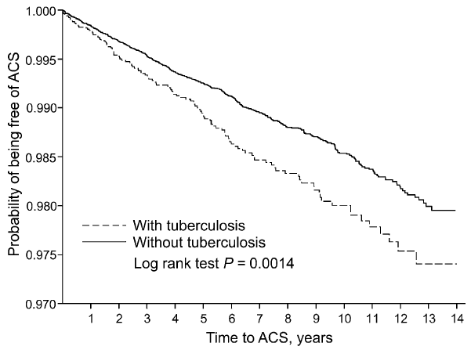
Acute Coronary Syndrome among 10,000
tuberculosis patients during follow-up in Taiwan
Chung W S, et al. Int J Tuberc Lung Dis 2014;18:79-83

Slide 31
Summary key points
o | Bacteriological cure ≠ full restoration of health
o | Pre-treatment disease presentation co-determines extent of sequelae
o | Remaining damage is both site-specific and systemic
o | Early diagnosis and prompt initiation of adequate chemotherapy reduces fatality, and risk for and extent of sequelae

Slide 32
A recent review on pulmonary tuberculosis,
sequelae and rehabilitation
Muñoz-Torrico M, Cid-Juárez S, Galicia-Amor S, Troosters T, Spanevello A.
Chapter 19. Sequelae assessment and rehabilitation
In: Migliori GB, Bothamley G, Duarte R, Rendon A, eds
Tuberculosis [ERS monograph]. Sheffield: European Respiratory Society; 2018:326-42
https://books.ersjournals.com/content/tuberculosis-9781849841009

