Slide 1
Interventions against tuberculosis:
The treatment of drug-susceptible
and drug-resistant tuberculosis
Antwerp, 11 April 2019
Hans L Rieder

Slide 2
Efficacy, effectiveness, efficiency…
Efficacy | What can the drug do? (ideal conditions, simulated in clinical trial settings: factually evaluating failure and relapse frequency)
Effectiveness | What does the drug do? (usual conditions, evaluated in field implementation, factually evaluating all adverse outcome frequency)
Efficiency | What does it take / cost to make it work?

Slide 3
An Epidemiologic Approach to Tuberculosis Interventions
Reduction of the incidence of tuberculous infection
 | Essence of the tuberculosis control strategy: identification and curative chemotherapy for cases transmitting M. tuberculosis
Reduction of the prevalence of tuberculous infection
 | Component of the tuberculosis elimination strategy: identification and preventive chemotherapy for persons already infected

Slide 4
Transmission
Chemotherapy
Doctor’s delay
Prophylactic
treatment
Preventive
therapy
Patient’s delay
Infectious
tuberculosis
Sub-clinical
infection
Exposure
Death
Non-infectious
tuberculosis
BCG
vaccination

Slide 5
Chemotherapy

Slide 6
Anti-Tuberculosis Drugs
Essential drugs: | Other drugs / classes:
Isoniazid | Other aminoglycosides
Rifampicin | Polypeptides
Pyrazinamide | Thioamides
Ethambutol | Cycloserine
Streptomycin | Para-amino salicylic acid
 | Fluoroquinolones
 | Diarylquinolines
 | Nitroimidazoles
 | Oxazolidinones

Slide 8
Chemical Structure of Isoniazid
O
NH-NH
2
C
N
Meyer H, Mally J. Monatshefte Chemie 1912;33:393-414

Slide 9
O
NH-NH
2
Model of Isoniazid Action
C
Isoniazid
N
Passive diffusion
KatG
activation
Reactive oxygen/
organic radicals
Antagonists
Efflux
NAT?
AhpC?
Multiple targets
DNA damage?
NAD metabolism?
Mycolic acid synthesis
InhA, KasA
Zhang Y, et al. In: Hatfull GF, et al.
Molecular Genetics of Mycobacteria, 2000

Slide 11
Isoniazid Adverse Drug Events
Frequent (≥ 5 per 100) | Common (≥1 per 100 and < 5 per 100) | Infrequent (≥ 1 per 1,000 and < 1 per 100) | Rare (≤ 1 per 1,000)
Liver enzyme elevations |  | Hepatitis Peripheral neuropathy Drug fever | Seizures Hallucinosis Psychosis Memory loss Optic neuropathy Pellagra Pyridoxine responsive anemia Metabolic acidosis Pyridoxine non-responsive psychosis Lupus erythematosus Hemolytic anemia Agranulocytosis Pure red cell aplasia Alopecia Asthma Dermatitis

Slide 14
Isoniazid Interactions
Effects of isoniazid potentiated | Effects of isoniazid opposed | Effect of drug potentiated by isoniazid | Effect of drug opposed by isoniazid
PAS Insulin Carbamazepine Theophylline | Prednisolone Ketoconazole | Anti-coagulants Anti-epileptics Benzodiazepines Haloperidol Tricylcic anti-depressants Theophylline | Enflurane

Slide 15
Chemical Structure of Rifampicin
CH
3
CH
3
OH
OH
OOCC
H
3
H
C
O
3
CH
OH
OH
3
H
3
C
NH
H
3
CO
CH
3
CH=N
N
N-CH
O
3
OH
O
O
CH
3
Maggi N, Pasqualuci C, Ballotta R, Sensi P.
Chemotherapy 1966;11:285-92

Slide 21
Rifampicin Adverse Drug Events
Frequent (≥ 5 per 100) | Common (≥1 per 100 and < 5 per 100) | Infrequent (≥ 1 per 1,000 and < 1 per 100) | Rare (≤ 1 per 1,000)
Bilirubin elevations in the beginning of treatment Orange discoloration of urine and tears Liver enzyme elevations |  | Hepatitis Pruritus Flu syndrome Drug fever | Interstitial nephritis Glomerulonephritis Renal failure Toxic epidermal necrolysis Oligomenorrhea Amenorrhea Anaphylactic shock Thrombocytopenia Neutropenia Leukopenia Hemolytic anemia Pseudomembranous colitis Eosinophilic colitis Lupus erythematosus Myopathy

Slide 22
Rifampicin Interactions
Effects of rifampicin potentiated | Effects of rifampicin opposed | Effect of drug potentiated by rifampicin | Effect of drug opposed by rifampicin
Co-trimoxazole |  | Acetominophen | Anti-arrhythmics Anti-asthmatics Anti-coagulants Anti-fungals Anti-malarials Anti-retroviral protease inhibitors Barbiturates Benzodiapezins Beta blockers Hormones Immunosuppressants Cardiac glycosides Opioids Vitamin K and D Trimethoprim

Slide 23
Chemical Structure of Pyrazinamide
N
O
C
NH
2
N
Kushner S, et al. Am J Chem Soc 1952;74:3617

Slide 25
Pyrazinamide Adverse Drug Events
Frequent (≥ 5 per 100) | Common (≥1 per 100 and < 5 per 100) | Infrequent (≥ 1 per 1,000 and < 1 per 100) | Rare (≤ 1 per 1,000)
Arthralgias | Nausea | Hepatitis Rash Nausea | Sideroblastic anemia Lupus erythematosus Convulsions Photodermatitis

Slide 26
Pyrazinamide Interactions
Effects of pyrazinamide potentiated | Effects of pyrazinamide opposed | Effect of drug potentiated by pyrazinamide | Effect of drug opposed by pyrazinamide
Allopurinol | Zidovudin (?) |  | Uricosuric drugs

Slide 27
Chemical Structure of Ethambutol
H
C
C
C
CH
OH
3
H
H
2
2
NH
.
(CH
)
2HCl
2
2
NH
H
C
C
C
CH
OH
3
H
H
2
2
Thomas JP, et al. Am Rev Respir Dis 1961;83:891-3

Slide 29
Ethambutol Adverse Drug Events
Frequent (≥ 5 per 100) | Common (≥1 per 100 and < 5 per 100) | Infrequent (≥ 1 per 1,000 and < 1 per 100) | Rare (≤ 1 per 1,000)
 |  | Retrobulbar neuritis Periaxial ocular toxicity | Aplastic anemia Eosinophilic pneumonia Thrompocytopenia Hyperuricemia

Slide 30
Ethambutol Interactions
Effects of ethambutol potentiated | Effects of ethambutol opposed | Effect of drug potentiated by ethambutol | Effect of drug opposed by ethambutol
None | Aluminum-magnesium antacids | None | None

Slide 31
Requirements from an Anti-Tuberculosis Drug
o | Ability to prevent emergence of resistance in the companion drug
o | Early bactericidal activity
o | Sterilizing activity
Mitchison DA. Tubercle 1985;66:219-25

Slide 34
Drug A
kills Drug B-resistant
mutants
Drug B
kills Drug A-
resistant mutants
Drug A
kills susceptible organisms
Drug B
kills susceptible organisms

Slide 35
Suffiently large number
of bacilli to contain
R-resistant mutants
Z + R treatment
Mutation frequency:
1 in 10⁶ to 1 in 10⁷
Non-acid pH!
Acid pH!
Too few bacilli to
contain Z-resistant
mutants
Z: Pyrazinamide
R: Rifampicin

Slide 37
Potential Risks for Acquisition of MDR
o | Settings with a high prevalence of initial isoniazid resistance
o | Settings with a high prevalence of HIV infection among tuberculosis patients
o | Settings with self-administered fixed-dose combinations

Slide 39
The Action of Anti-Tuberculosis Drugs
Extent of activity | Prevention of resistance | Early bactericidal activity | Sterilizing activity
High | Isoniazid | Isoniazid | Rifampicin
 | Rifampicin |  | Pyrazinamide
 |  | Ethambutol
 | Ethambutol | Rifampicin | Isoniazid
 | Streptomycin
 |  | Streptomycin | Streptomycin
 | Pyrazinamide | Pyrazinamide | Thioacetazone
Low | Thioacetazone | Thioacetazone | Ethambutol
Mitchison DA. Tubercle 1985;66:219-25

Slide 42
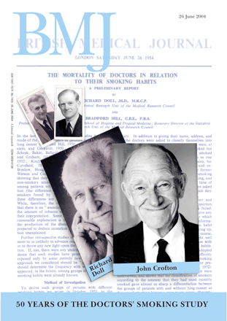
1954
2004

Slide 44
Monoresistance:
1 drug
Polyresistance:
2 or more drugs
MDR “plus”:
RMP-INH-FQ
or
RMP-INH-Inj
MDR “simple”:
RMP-INH
only
Other drugs
Isoniazid
Other polyresistance
XDR: RMP-INH-FQ-Injectable
Schematic: not a real quantitative distribution!
INH-RMP = “MDR”

Slide 45
Principle of the cascade of regimens
Provide a clinical trial-established first-line
regimen with high likelihood of success
to all new patients
Provide a second-line regimen with high
likelihood of success to all patients with a
non-successful prior treatment outcome
requiring re-treatment (failure, return
after default, recurrent tuberculosis)

Slide 46
Basic Chemotherapy Regimens Tested in Clinical Trials
Duration (mo) | Intensive | Continuation
6 | 2 SHRZ | 4 RH
6 | 2 EHRZ | 4 RH
8 | 2 SHRZ | 6 TH
8 | 2 EHRZ | 6 EH
12 | 2 STH | 10 TH

Slide 47
The original cascade in Union programs, considering the then worst-case scenario of initial isoniazid resistance, using essential drugs
 | Among true failures, at point of failure:
 |  | 2 SHRZ / 6 TH
East African Medical Research Council, British Medical Research Council. Tubercle 1980;61:59-69
 | Re-treatment regimen:
 |  | 2 SEHRZ / 1 EHRZ / 5 EHR

Slide 48
Frequent Case: Initial INH Resistance
“Conservative” approach | “Modern” approach
2 EHRZ / 6 EH | 2 EHRZ / 4 HR
Failure / relapse: relatively frequent | Failure / relapse: relatively infrequent
Susceptible organisms:
Clinical trial efficacy: | Clinical trial efficacy:
5% failures 10% relapses | 3% failures 5% relapses
15% unfavorable total | 8% unfavorable total
Jindani A, et al. Lancet 2004;364:1244-51

Slide 49
Frequent Case: Initial INH Resistance
“Conservative” approach | “Modern” approach
2 EHRZ / 6 EH | 2 EHRZ / 4 HR
Failure / relapse: relatively frequent | Failure / relapse: relatively infrequent
True failures:
EH resistance at point of failure | HR resistance at point of failure

Slide 50
Frequent Case: Initial INH Resistance
“Conservative” approach | “Modern” approach
2 EHRZ / 6 EH | 2 EHRZ / 4 HR
Failure / relapse: relatively frequent | Failure / relapse: relatively infrequent
2 SEHRZ / 6 EHRZ | 2 SEHRZ / 1 EHRZ / 5 EHR
Failure => MDR Relatively infrequent | Failure => MDR + E_{res} Relatively frequent
Failures of failures: appropriate numerator

Slide 51
«....Current treatment regimens for MDR-TB are far from satisfactory: the overall duration is 20 months or more, requiring daily administration of drugs that are more toxic and less effective than those used to treat drug-susceptible TB, and have a high cost. Among MDR-TB patients started on treatment globally in 2009, only 48% were treated successfully, largely as a result of a high frequency of patient deaths (15%) and loss to follow-up (28%), which is commonly associated with adverse drug reactions, among other factors....»
World Health Organization 2013;WHO/HTM/TB/2013.6:1-57

Slide 52
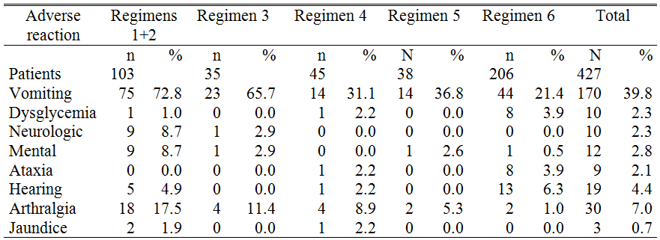
Treatment of MDR tuberculosis in Damien Foundation
Projects, Bangladesh, 1997-2007
Van Deun A, et al. Am J Respir Crit Care Med 2010;182:684-92

Slide 55
The (minimum) 9-month regimen for MDR in Bangladesh (220 €)
Kanamycin
4-month intensive phase prolonged
if still smear-positive after 4 months
Fixed 5-month continuation phase
Prothionamide
Isoniazid
Gatifloxacin
Ethambutol
Pyrazinamide
Clofazimine
Aung K J M, et al. Int J Tuberc Lung Dis 2014;18:1180-7

Slide 57
Aung K J M, et al. Int J Tuberc Lung Dis 2014;18:1180-7

Slide 59
The regimen cascade by core drug
8-mo INH-throughout regimen:
H
res ?
no
2 E-H-R-Z / 6 T-H
≥ 80% effective
yes
H monoresistance
8-mo RMP-throughout regimen:
R
res ?
no
2 S-E-H-R-Z / 1 E-H-R-Z / 5 H-R-Z
≥ 80% effective
yes
MDR
9- to 11-mo FQ-throughout regimen:
FQ-K
res ?
no
4(+) K-G-T-C-H-E-Z / 5 G-C-E-Z
≥ 80% effective
yes
(Pre-)XDR
Complex if XDR! Toxic! 21-mo regimen – poor effectiveness (50%)

Slide 60
Two of the current challenges
o | Early diagnosis of MDR to escape the need for a streptomycin-containing second-line regimen (cutting out one step in the cascade)
o | Fall-back regimen for patients failing on the Bangladesh regimen (XDR), i.e. the next step in the treatment cascade

Slide 61
Early diagnosis of MDR
o | Check patients on first-line regimen with Xpert MTB/RIF at 2 (?) or latest 5 months if sputum smear-positive
o | If Xpert MTB/RIF positive, but rifampicin-susceptible, disregard and complete regimen
o | If Xpert MTB/RIF rifampicin-resistant, and confirmed on a second specimen switch to the Bangladesh regimen

Slide 62
No
2 SHRZ / 6 TH
H_{r}
Cascade of regimens
≥ 80% effective
Yes
No
{HR}_{r}
2 EHRZ / 4 RH
Established
with available
generic drugs
≥ 80% effective
Yes
Bangladesh-type
regimen
No
{HR+}_{r}
≥ 80% effective
Yes
Requires
new drug
classes
{HRIF}_{r}
{HRF}_{r}
{HRI}_{r}
XDR
“MDR-plus”

Slide 63
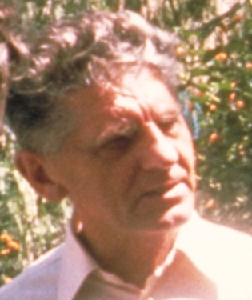

Isoniazid
3+ SPH / 10 PH
2 SHRZ / 6 TH
Rifampicin
2 SEHRZ / 1 ERHZ / 5 ERH
Gatifloxacin
4+ KGZCEHPt / 5 GZCE

