Slide 1
Introduction to the definitions of some epidemiologic terms
Antwerp, 28 January 2020 Hans L Rieder

Slide 2
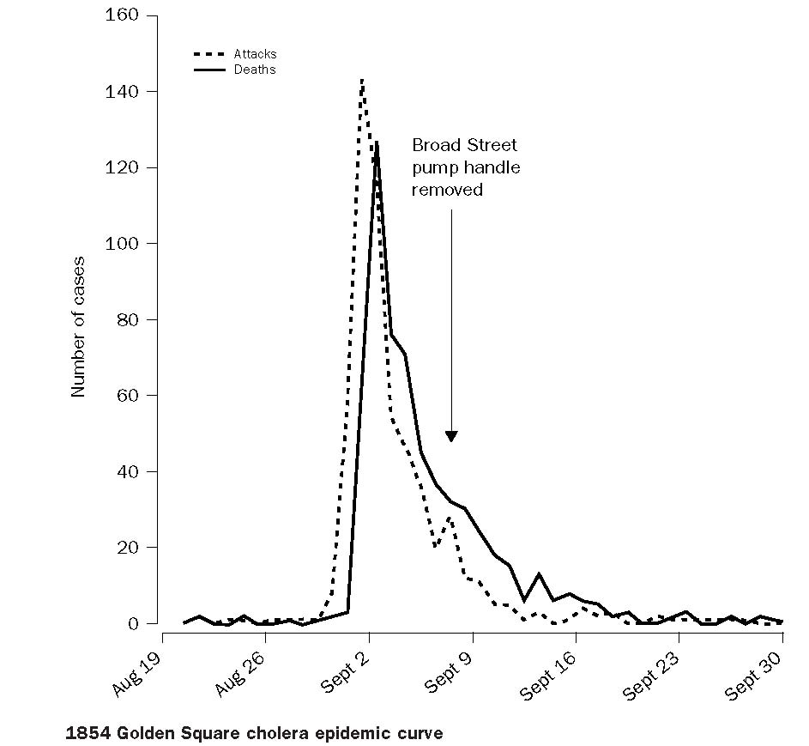
“In theory, there’s no difference between theory and practice, but
in practice there is”
1854 Golden Square
Epidemic curve
Snow J. On the mode of communication of cholera. London: John Churchill, 1855
Pharoah P. Lancet 2004;363:1552

Slide 3
Some Epidemiologic Terms
Incidence:
 | Newly emerging cases during a specified period of time
(Point) prevalence:
 | Existing cases at a specified point in time
Relation between prevalence and incidence:
 | Prevalence = Incidence x time

Slide 4
Some Epidemiologic Terms
Proportion:
 | Fraction calculated from numerator divided by denominator (which contains numerator)
Example:
 | A parliament has 164 members, of which 68 are female and 96 are male
Fraction female:
 | 68 / (68+96) = 0.415

Slide 5
Some Epidemiologic Terms
Ratio:
 | Result of division of one number (numerator) by another number (denominator) (which does not usually contain numerator)
Example:
 | A parliament has 164 members, of which 68 are female and 96 are male
Female-to-male ratio: |  | Male-to-female ratio:
 | 68 / 96 = 0.708 |  | 96 / 68 = 1.412

Slide 7
Some Epidemiologic Terms
Rate:
 | Number of events (numerator) divided by the (population times person-time) (denominator)
Example incidence rate:
 | 400 new tuberculosis cases occur in a community of 25,000 people over a period of 2.5 years
 | ?

Slide 8
Some Epidemiologic Terms
Rate:
 | Number of events (numerator) divided by the (population times person-time) (denominator)
Example incidence rate:
 | 400 new tuberculosis cases occur in a community of 25,000 people over a period of 2.5 years: 400 / (25,000 x 2.5) = 0.0064
or | 6.4 cases per 1,000 person-years observation
or | 640 cases per 100,000 person-years observation

Slide 9
Design of a Prospective Study
 | Outcome
Exposure | Ill | Healthy | Person-yrs of observation
Yes | A | B | N₁
No | C | D | N₂
Total | A+C | B+D | N₁ + N₂
Incidence rate among the exposed: |  |  | A / N₁
Incidence rate among the non-exposed: |  |  | C / N₂
Incidence rate ratio (“relative risk”): |  |  | (A/N₁) /(C/N₂)

Slide 10
Protection from Tuberculosis by BCG in Adolescents in the United Kingdom
 | Outcome
BCG | Tuberculosis | Healthy | Person-yrs of observation
Yes | 88 | B | 19,415
No | 248 | D | 12,867
Total | 336 | B+D | 32,282

Slide 11
Protection from Tuberculosis by BCG in Adolescents in the United Kingdom
 | Outcome
BCG | Tuberculosis | Healthy | Person-yrs of observation
Yes | 88 | B | 19,415
No | 248 | D | 12,867
Total | 336 | B+D | 32,282
IR among the exposed: |  |  | 88/19,415=0.0045
IR among the non-exposed: |  |  | 248/12,867=0.0193
IR ratio (“relative risk”): |  |  | 0.0045/0.0193=0.24

Slide 12
Design of a Retrospective Study
 | Outcome
Exposure | Case | Control | Total
Yes | a | b | n₁
No | c | d | n₂
Total | a+c | b+d | n₁ + n₂
Odds of exposure among cases: |  |  | a / c
Odds of exposure among controls: |  |  | b / d
Relative odds (odds ratio): |  |  | (a * d) / (b * c)

Slide 13
Example Tuberculous Meningitis in a Case Control Study
 | Tuberculous meningitis
BCG vaccinated | Case | Control | Total
Yes | 13 | 30 | 43
No | 32 | 15 | 47
Total | 45 | 45 | 90

Slide 14
Example Tuberculous Meningitis in a Case Control Study
 | Tuberculous meningitis
BCG vaccinated | Case | Control | Total
Yes | 13 | 30 | 43
No | 32 | 15 | 47
Total | 45 | 45 | 90
Odds of exposure among cases: |  |  | a/c=13/32=0.406
Odds of exposure among controls: |  |  | b/d=30/15=2.000
Relative odds (odds ratio): |  |  | (a*d)/(b*c)=0.203

Slide 15
Protection: Efficacy – clinical trials Effectiveness – case-control studies
Measure | Calculation | Result (protection)
Relative risk | 1 – RR | ?
Odds ratio | 1 – OR | ?

Slide 16
Protection: Efficacy – clinical trials Effectiveness – case-control studies
Measure | Calculation | Result (protection)
Relative risk | 1 – RR | 1 – 0.235 = 0.764
Odds ratio | 1 – OR | 1 – 0.203 = 0.797

Slide 17
Calculating the Predictive Value of a Test Result
Prevalence: | (a+c)/N | Sensitivity: | a/(a+c)
 |  | Specificity: | d/(b+d)
Test result | Presence of characteristic
 | Yes | No | Total
Positive | a | b | a+b
Negative | c | d | c+d
Total | a+c | b+d | a+b+c+d=N
Predictive value of a positive test result: |  |  | a/(a+b)

Slide 18
Calculating the Predictive Value of a Test Result
Prevalence: | 0.1 | Sensitivity: | 0.9
 |  | Specificity: | 0.9
Test result | Presence of characteristic
 | Yes | No | Total
Positive | a | b | a+b
Negative | c | d | c+d
Total | a+c | b+d | 1,000
Predictive value of a positive test result: |  |  | a/(a+b)

Slide 19
Calculating the Predictive Value of a Test Result
Prevalence: | 0.1 | Sensitivity: | 0.9
 |  | Specificity: | 0.9
Test result | Presence of characteristic
 | Yes | No | Total
Positive | a | b | a+b
Negative | c | d | c+d
Total | 100 | b+d | 1,000
Predictive value of a positive test result: |  |  | a/(a+b)

Slide 20
Calculating the Predictive Value of a Test Result
Prevalence: | 0.1 | Sensitivity: | 0.9
 |  | Specificity: | 0.9
Test result | Presence of characteristic
 | Yes | No | Total
Positive | a | b | a+b
Negative | c | d | c+d
Total | 100 | 900 | 1,000
Predictive value of a positive test result: |  |  | a/(a+b)

Slide 21
Calculating the Predictive Value of a Test Result
Prevalence: | 0.1 | Sensitivity: | 0.9
 |  | Specificity: | 0.9
Test result | Presence of characteristic
 | Yes | No | Total
Positive | 90 | b | a+b
Negative | c | d | c+d
Total | 100 | 900 | 1,000
Predictive value of a positive test result: |  |  | a/(a+b)

Slide 22
Calculating the Predictive Value of a Test Result
Prevalence: | 0.1 | Sensitivity: | 0.9
 |  | Specificity: | 0.9
Test result | Presence of characteristic
 | Yes | No | Total
Positive | 90 | b | a+b
Negative | 10 | d | c+d
Total | 100 | 900 | 1,000
Predictive value of a positive test result: |  |  | a/(a+b)

Slide 23
Calculating the Predictive Value of a Test Result
Prevalence: | 0.1 | Sensitivity: | 0.9
 |  | Specificity: | 0.9
Test result | Presence of characteristic
 | Yes | No | Total
Positive | 90 | b | a+b
Negative | 10 | 810 | c+d
Total | 100 | 900 | 1,000
Predictive value of a positive test result: |  |  | a/(a+b)

Slide 24
Calculating the Predictive Value of a Test Result
Prevalence: | 0.1 | Sensitivity: | 0.9
 |  | Specificity: | 0.9
Test result | Presence of characteristic
 | Yes | No | Total
Positive | 90 | 90 | a+b
Negative | 10 | 810 | c+d
Total | 100 | 900 | 1,000
Predictive value of a positive test result: |  |  | a/(a+b)

Slide 25
Calculating the Predictive Value of a Test Result
Prevalence: | 0.1 | Sensitivity: | 0.9
 |  | Specificity: | 0.9
Test result | Presence of characteristic
 | Yes | No | Total
Positive | 90 | 90 | 180
Negative | 10 | 810 | 820
Total | 100 | 900 | 1,000
Predictive value of a positive test result: |  |  | a/(a+b)

Slide 26
Calculating the Predictive Value of a Test Result
Prevalence: | 0.1 | Sensitivity: | 0.9
 |  | Specificity: | 0.9
Test result | Presence of characteristic
 | Yes | No | Total
Positive | 90 | 90 | 180
Negative | 10 | 810 | 820
Total | 100 | 900 | 1,000
Predictive value of a positive test result: |  |  | 0.5

Slide 27
Example for the Dependence of the Predictive Value
of a Positive Test on the Prevalence
Example 1:
90% Sensitivity
90% Specificity
40% Prevalence
Example 2:
90% Sensitivity
90% Specificity
10% Prevalence
Condition
Test present absent total
pos 360 60 420
neg 40 540 580
tot 400 600 1000
Condition
Test present absent total
pos 90 90 180
neg 10 810 820
tot 100 900 1000
Predictive value of a positive test:
360 / 420 = 86%
Predictive value of a positive test:
90 / 180 = 50%

Slide 28
Which operating characteristic from a
diagnostic test do you prefer to be high –
sensitivity or specificity?

Slide 29
Test characteristic | Truth
 | The person is breaking the law | The person is law-abiding
High sensitivity | Catch as many law-breakers as possible | Accept to throw law-abiding people to jail
High specificity | Accept to let a law-breaker to run free | Don’t put law-abiding persons to jail

