Slide 1
How you can access the material:
Type into your browser’s address bar:
www.tbrieder.org
In the navigation panel click:
Presentations

Slide 2
Bacteriologic Basis of Tuberculosis Control
Base bactériologique de la lutte contre la
tuberculose
Antwerp, 10 April 2019
Hans L Rieder

Slide 3
An introduction to the mycobacteria

Slide 4
Species: | M. tuberculosis, M. avium, M. xy, ≈ 200 known species
Genus: | Mycobacterium
Family: | Mycobacteriaceae
Suborder: | Corynebacterineae
Order: | Actinomycetales
Class: | Actinobacteria
Phylum:
Kingdom: | Bacteria
Domain: | -
Life: | -

Slide 5
An anthropo-centric view
Species group | Significance | Species examples
M tuberculosis complex | Primary host man | M tuberculosis, (M canettii, M africanum)
 | Primary host animal | M bovis, M caprae
Leprosy bacillus | Primary host man (and armadillo) | M leprae
Environmental mycobacteria, often opportunists in man | Environment and some animal hosts | M avium, M chelonae, M kansasii, M malmoense, etc, etc
Environmental mycobacteria, rarely opportunists in man | Environment and some animal hosts | M marinum, M szulgai, M xenopi, M simiae, M ulcerans, etc, etc

Slide 6
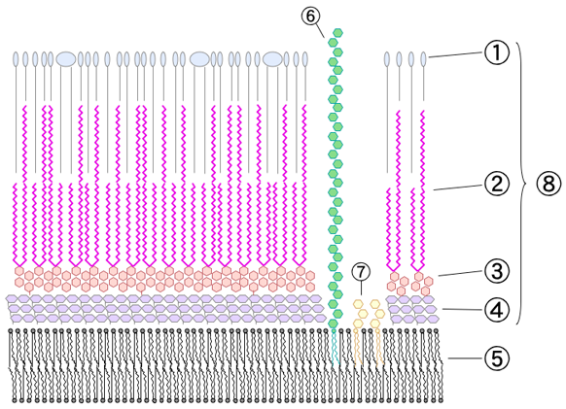
The cell wall of Mycobacterium tuberculosis
Lipoarabinomannan
Outer
lipids
Mycolic
acid
Cell wall skeleton
Phosphatidylinositol mannoside
Polysaccharides (arabinogalactan)
Peptidoglycan
Plasma membrane
Wikipedia: https://en.wikipedia.org/wiki/Mycobacterium.
Accessed 1 April 2019

Slide 7
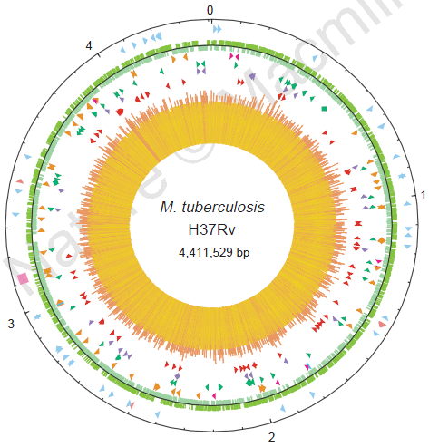
The genome of Mycobacterium tuberculosis
Circular map of the chromosome of
M. tuberculosis H37Rv
Cole S T, Brosch R, Parkhill J, Garnier T, Churcher C, Harris D, et al.
Nature 1998;393:537-44

Slide 8
Laboratory methods

Slide 9
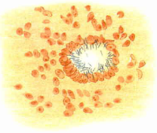
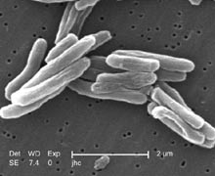
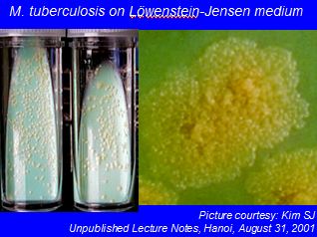
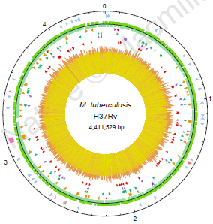
Morphology
Metabolism
Koch R, 1884
Wikipedia, 2008
Genome
How does it look?
How does it reproduce?
What makes it function?
Cole ST, et al. Nature 1998;393:537-44

Slide 10
Procedures and Techniques
Procedural step | Technique | Specification
Specimen | Collection | Biological material
 | Transport | Preserve viability, reduce contamination
 | Processing | Decontamination, concentration
Identification | Morphology | Microscopy
 | Metabolism | Growth observation
 |  | Measuring metabolism
 | Genome | Identification of genetic components
 | Immunologic response | Histology
 |  | Serologic markers
 |  | Ex vivo response (tuberculin)
 |  | In vitro response (INF-γ)

Slide 11
Laboratory methods:
Specimen collection

Slide 12
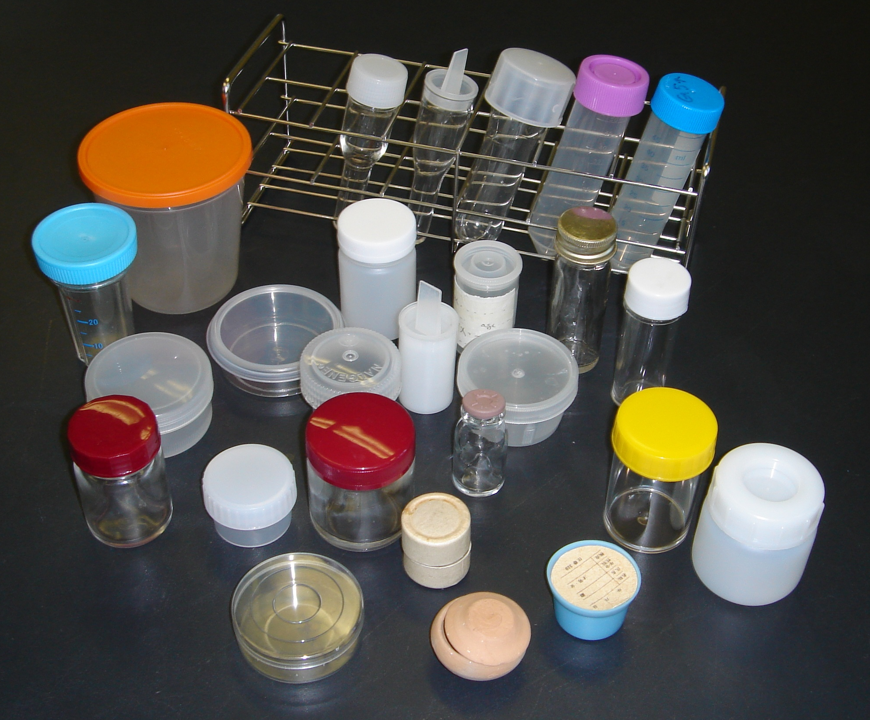
Slide courtesy: Kim SJ. Unpublished lecture notes, Hanoi, September 2008
Notes:
12

Slide 14
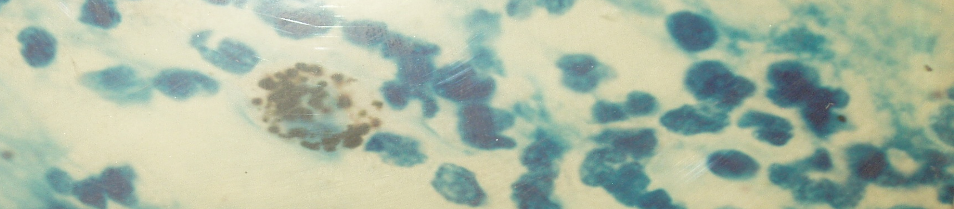
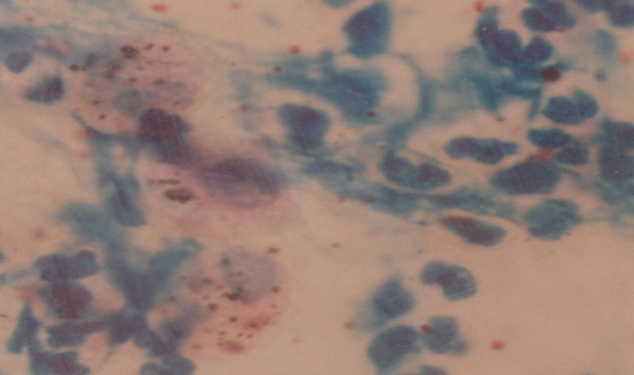
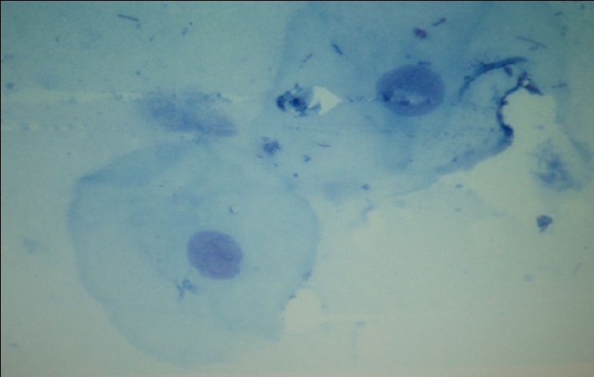
Evaluation of sputum quality by counting sputum cells
Macrophages/
Polymorphonulcear
leukocytes
Epithelial cells
Picture courtesy:
Kim SJ. Unpublished lecture notes, Union Hanoi course, 4 September 2008

Slide 15
Laboratory methods:
Specimen transport

Slide 17
Laboratory methods:
Specimen processing

Slide 19
Acid-fast microscopy

Slide 20
Acid-fast microscopy:
Smear preparation

Slide 21
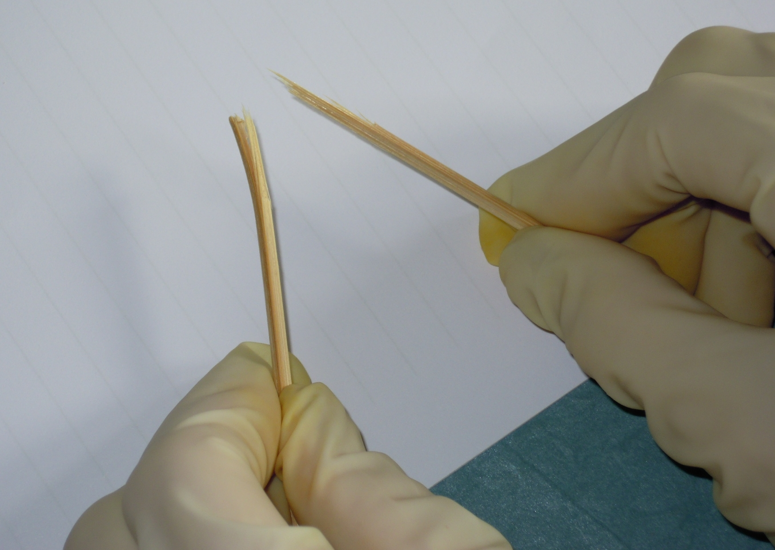
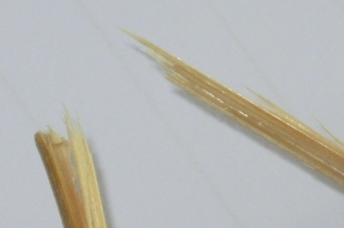

Slide 22
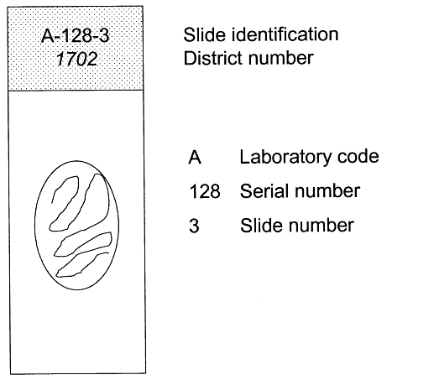
Properly labeling a slide
Rieder H L, Van Deun A, Kam K M, Kim S J, Chonde T M, Trébucq A, Urbanczik R.
Priorities for tuberculosis bacteriology services in low-income countries. Second edition.
Paris: International Union Against Tuberculosis and Lung Disease, 2007

Slide 23
Acid-fast microscopy:
Smear staining

Slide 24
Microscopy methods
o | Brightfield microscopy
o | Fluorescence microscopy

Slide 25
Light source
Optical system
Optical system
Optical system
Slide
Slide
Slide
Light source
Epi-fluorescence
Light source
Fluorescence
microscopy
LED fluorescence
microscopy
Bright field
microscopy
LED fluorescence
microscopy

Slide 26
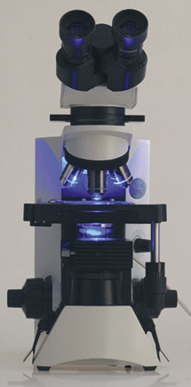
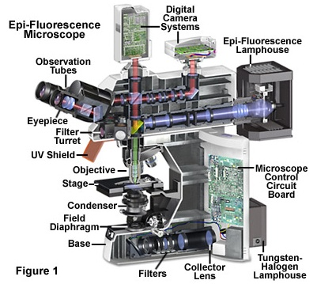
Principle of “add-on” LED module
in transmission mode
(Example: Fraen system)
Principle of classical epi-fluorescence
(Example: Nikon system)
Added to an existing bright-field
microscope without interference
with the existing white-light function

Slide 27
The “Ziehl-Neelsen” staining technique: an experimental path to optimization, ready and all set since 1882
Contributor | Contribution
Robert Koch | Primary stain: methylene blue, alkaline potassium hydrate as mordant, vesuvium as both decolorant and counterstain
Paul Ehrlich | Fuchsin as primary stain, alkaline alinine as mordant, nitric acid as decolorant, and proposal of a blue counterstain
Franz Ziehl | Replace mordant with phenol
Friedrich Neelsen | Combine the best of all: primary and counterstain from Ehrlich, mordant from Ziehl, and replacing decolorant with sulphuric acid
Bishop P J, Neumann G. The history of the Ziehl-Neelsen stain. Tubercle 1970;51:196-206

Slide 28
Some differences between microscopy techniques
 | Bright-field | Fluorescence (classic) | Fluorescence (LED)
Stain | Fuchsin | Auramine | Auramine
Time for proper examination | 5 to 10 min | 2 min | 2 min
Microscope cost (€) | 1,000 | 8,000 | 1,000
Module cost (€) | -- | -- | 1,000
Lamp life (hr) | 10,000 | 200 | 100,000
Maintenance cost | Low | Very high | Low
Acceptability | High | Often very low | High

Slide 29
Principle of staining
AFB
Non AFB
carbol-fuchsin (or auramine)
decolorize
counterstain
Slide courtesy: Van Deun A, unpublished lecture notes,
Union International Tuberculosis Course, Arusha, November 2009

Slide 30
Principles in two types of microscopy
Staining | Bright-field microscopy | Flurorescence microscopy
Primary stain (stains everything) | Fuchsin | Auramine
Decolorant (destains everything except mycobacteria) | Hydrochloric acid or Sulfuric acid | Hydrochloric acid
Counter-stain (stains everything except color-saturated mycobacteria) | Methylene blue | Methylene blue or Other

Slide 31
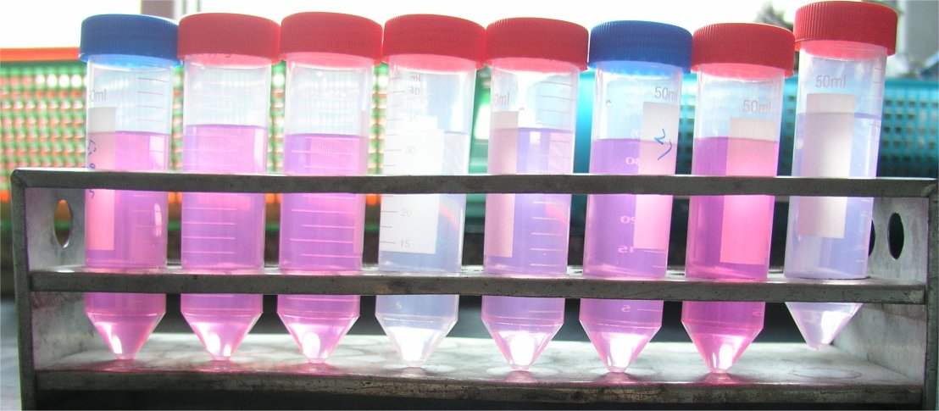
Visualizing the fuchsin content of different stains by dilution
Slide courtesy: Kam KM. Unpublished lecture notes, Union International Tuberculosis Course
Hanoi, Viet Nam, September 2008

Slide 32
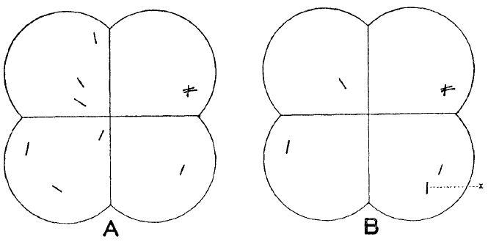
Lower sensitivity of Ziehl-Neelsen or
lower specificity of fluorescence microscopy?
Fluorescence microscopy
Ziehl-Neelsen
Richards OW et al. Am Rev Tuberc 1941;44:255-66

Slide 33
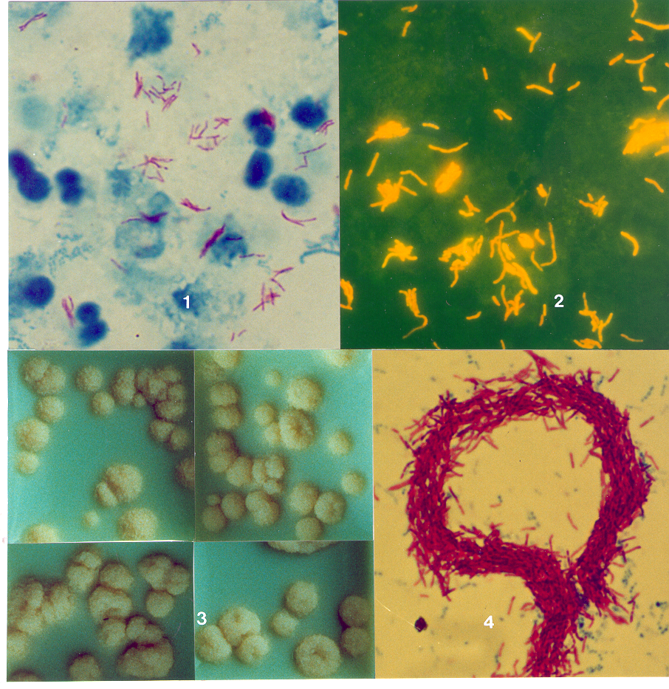
Appearance of AFB in bright-field and fluorescence microscopy
Ziehl-Neelsen
Fluorescence
Picture courtesy:
Kim SJ. Unpublished lecture notes, Union Hanoi course, 4 September 2008

Slide 34
Acid-fast microscopy:
Smear reading

Slide 35
Sequence of events that determine
sensitivity of microscopy
Extent of disease
Quality of specimen
Quality of smear, stains, and staining
Quality of optical system of microscope
Number of fields examined
Number of specimens examined

Slide 36
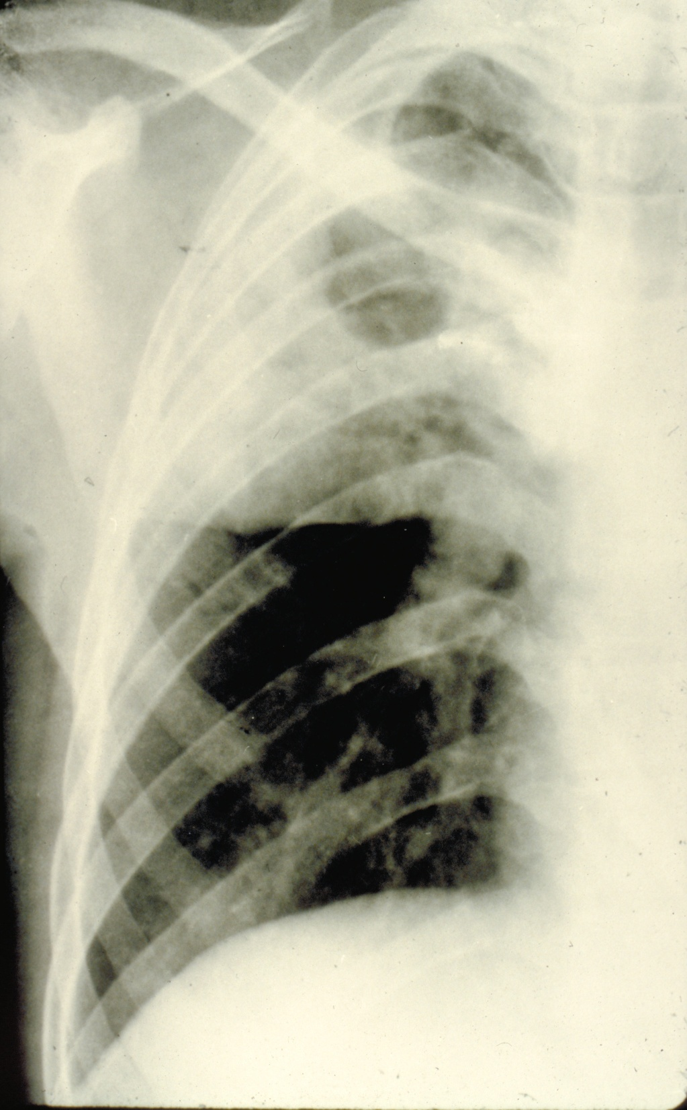
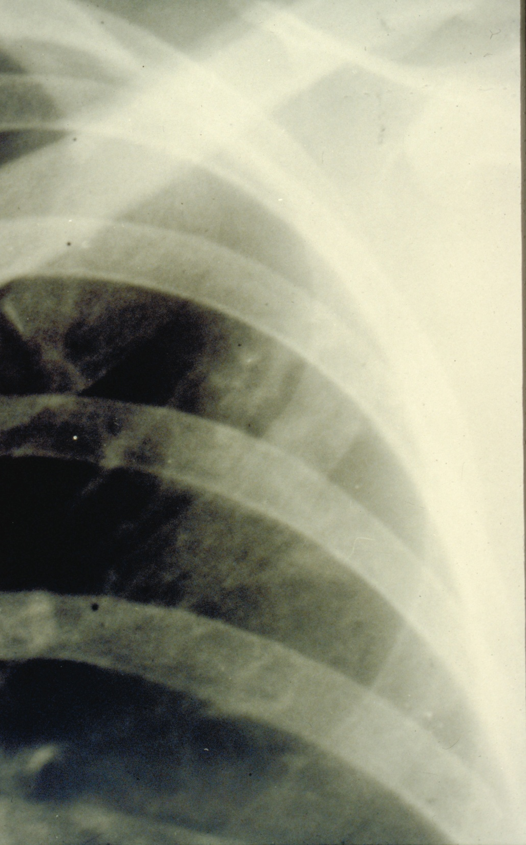

Slide 37
Schematic Presentation of Relative Frequency of Patients,
Number of bacilli, and Available Diagnostic Methods
Rieder H L, Van Deun A, Kam K M, Kim S J, Chonde T M, Trébucq A, Urbanczik R.
Priorities for tuberculosis bacteriology services in low-income countries. Second edition.
Paris: International Union Against Tuberculosis and Lung Disease, 2007

Slide 39



1 Oil immersion field
0.02mm²
To see:
1 AFB in 100 fields
requires:
smear surface of 200 mm²
containing 100 AFB
10mm
20mm
1 Length = 100 OIF
1 drop = 0.01 mL
which requires:
1 mL sputum
containing 10,000 AFB
1 mL Sputum

Slide 40
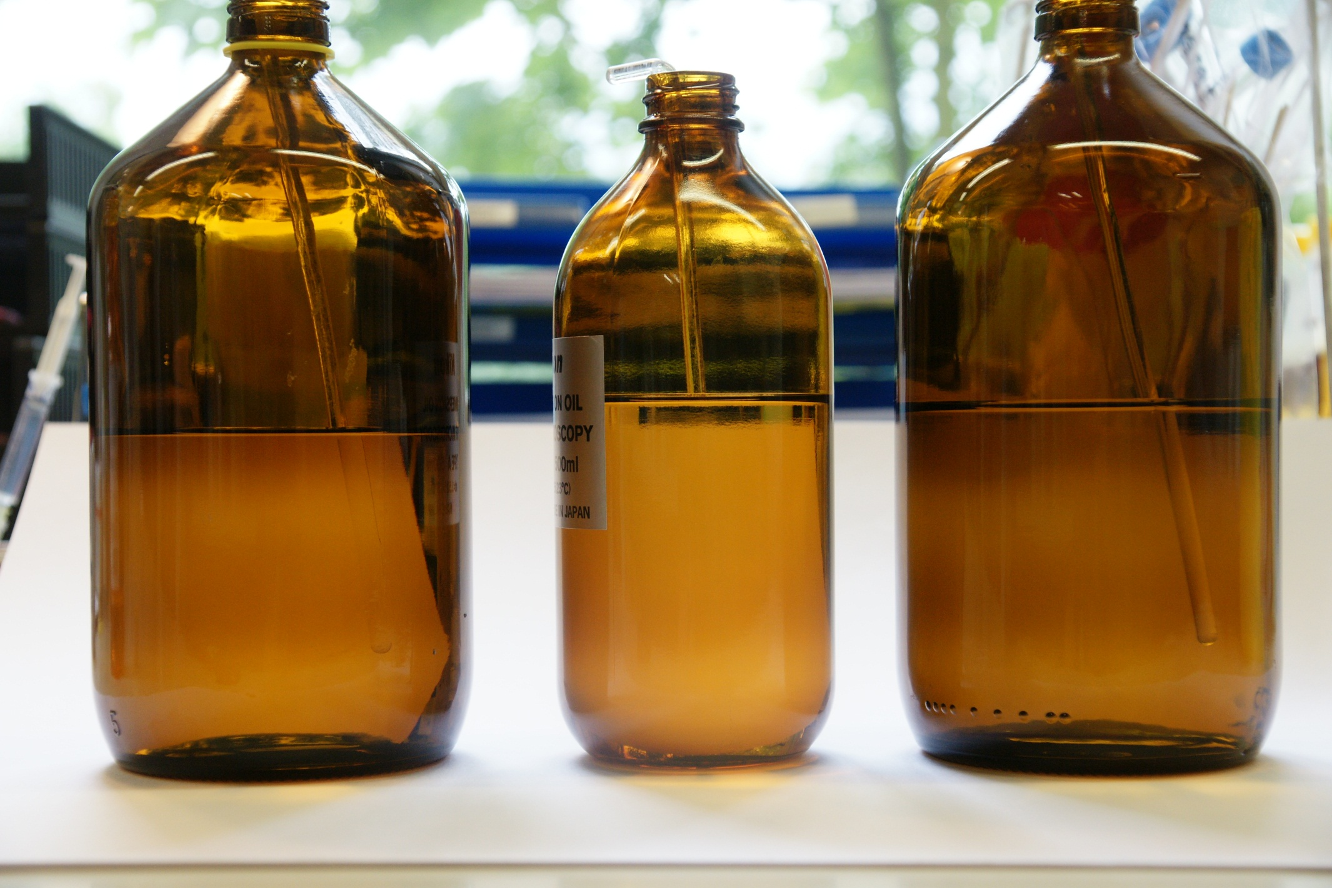
Glass rod (Refraction index 1.513) in sunflower oil, immersion oil, and water
Sunflower oil
RI: 1.464
Immersion oil
RI: 1.515
Water
RI: 1.333

Slide 43
Culture for mycobacteria

Slide 44
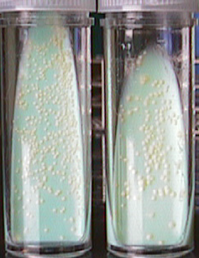
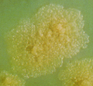
M. tuberculosis on Löwenstein-Jensen medium
Picture courtesy: Kim SJ
Unpublished Lecture Notes, Hanoi, August 31, 2001

Slide 45
Mycobactericidal Effects of Decontaminants
 | NALC- 2% NaOH | Na₃PO₄ | 4% NaOH
Initial kill | 30% | 40% | 40%
Kill during centrifu- gation | 6% | - | 20%
Lost due to centrifu- gation | 6% | 6% | 12%
Total lost | 42 % | 46% | 72%
M. tuberculosis
M. fortuitum
1% NaOH
2% NaOH
5% oxalic acid
5% oxalic acid
1% NaOH
Slide courtesy:
Kim SJ. Unpublished lecture notes, Union Hanoi course, 4 September 2008
Notes:
45

Slide 46
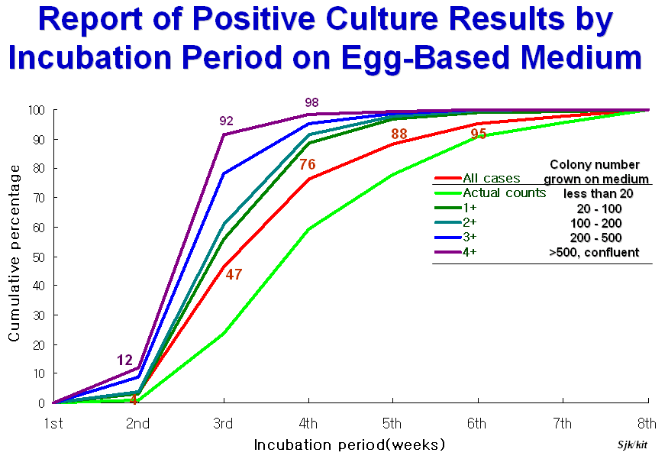
Slide courtesy: Kim S J. August 25, 2007

Slide 50
Specificity of culture
In principle close to 100%
  species identification possible
  distinguish living from dead bacilli
But more sensitive to deficient technique
  specimen carry-over
  2-5% false positives (Mitchison, BMRC labs)
  contaminants read as TB
Slide courtesy: Van Deun A. November 18, 2008

Slide 51
Sensitivity of culture
Advantage over smear depends on population
  patient delay: low income versus industrialised
  HIV status and stage
  active versus passive case detection
    NTI Bangalore studies: 45% versus 85% of culture-positives detected by smear
Slide courtesy: Van Deun A. November 18, 2008

Slide 52
Delay
May be unacceptable
  even MGIT... needs 2-3 weeks in SM-
  chest X-Ray done simultaneously (sm-/cu- TB)
  experience: culture results not used
→ rather confirmation of diagnosis
Slide courtesy: Van Deun A. November 18, 2008

Slide 53
Accessibility
Problematic in low-income
  difficult to set up a sufficiently dense network
    infrastructure, trained staff, equipment
    → transport delays and serious contamination problems
  financial accessibility
    will diagnosis be free with expensive tests?
Slide courtesy: Van Deun A. November 18, 2008

Slide 54
Other methods than
microscopy and culture:
Tests based on identifying genome components

Slide 55
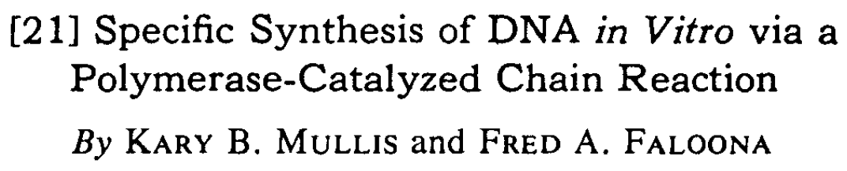
Methods Enzymol 1987;155:335-51
The principle of Polymerase Chain Reaction
Two DNA targets
available for PCR
DNA denaturated
PCR
amplification
cycle
Double stranded DNA duplicated
Primers bind to target DNA
Taq polymerase
rebuilds DNA

Slide 57
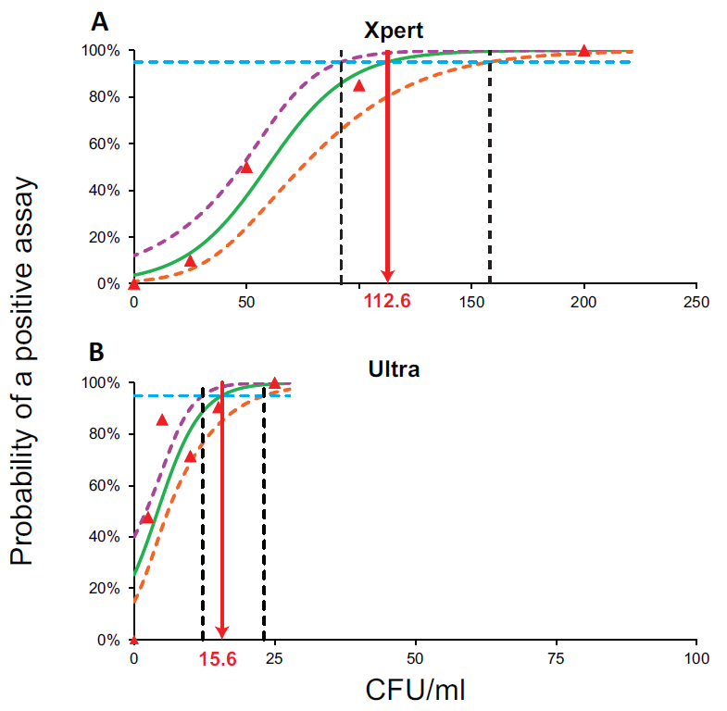


Chakravorty S, et al. mBio 2017;8:e00812-17

Slide 59
Laboratory network in a
National Tuberculosis Control Program

Slide 60
Microscopy network

Slide 61
TB laboratory services
Pyramidal structure recommended
  to maintain proficiency
    mainly susceptibility testing
    but also smear!
  for maximum efficiency and cost-effectiveness
  in line with overall development
    infrastructure; human and other resources
    e.g. culture: up to which level?
Slide courtesy: Van Deun A. November 18, 2008

Slide 63


Slide 64
How do we sample laboratories?
R

Slide 65
30 randomly selected clusters as in EPI?
R

Slide 66
All laboratories by the
National Reference Laboratory?
R

Slide 67
All peripheral laboratories by the intermediate laboratories, and
the latter by the National Reference Laboratory?
R

Slide 68
Sampling approach
Clusters | Provides information about the country performance, but cannot help quality improvement
All by RefLab | Provides information on each laboratory, but impossible workload for the Reference laboratory
Hierarchical | Only practical approach

Slide 69
How to sample slides within one laboratory?

Slide 70
Sampling all positive and 10% of all negative slides?
Laboratory A: 242 slides
Laboratory B: 36 slides
Proportion pos = 0.15
Sample: 36 pos + 20 neg = 56 slides
Proportion pos = 0.25
Sample: 9 pos + 3 neg = 12 slides

Slide 71
Sampling all positive and 10% of all negative slides
o | Experienced laboratories with high turnover are sampled excessively
o | Difficult slides (low scanty, but reported as negative) are under-sampled

Slide 72

Finding out which new computers are faulty or finding
out what proportion of computers is faulty?

Slide 73
How industry approaches the problem
o | We will replace a new faulty computer with a new one
o | We need to know the proportion of faulty computers in a lot in order to know how much it costs us to replace all new faulty computers
o | The number of computers to be submitted to thorough testing to determine that proportion must be as small as possible within a lot to reduce testing costs

Slide 74
Lot Quality Assurance Sampling Phrasing the hypothesis
“I am 95% certain that not more than 5% of reportedly negative slides are actually missed positive slides”

Slide 75
What is the difference between false negative and false positive slides?
o | Reducing false negative slides improves laboratory performance
o | Every false positive slide is a rare, but very serious problem – each one must be followed up

Slide 76
Grading Performance – International Recommendation
Examinee’s result | Superior level control result
 | Negative | 1-9 / 100 | 1 + | 2 + | 3 +
Negative | Correct | LFN | HFN | HFN | HFN
1-9 / 100 | LFP | Correct | Correct | QE | QE
1+ | HFP | Correct | Correct | Correct | QE
2 + | HFP | QE | Correct | Correct | Correct
3 + | HFP | QE | QE | Correct | Correct

Slide 77

The international consensus
Monograph found on CD-ROM
Aziz M A, Ba F, Becx-Bleumink M, Bretzel G,
Humes R, Iademarco M F, et al.
External quality assessment for AFB smear
microscopy.
Washington, DC: Association of Public Health
Laboratories, 2002.

Slide 78
Definition of a patient suspected to have tuberculosis (now also called “presumptive TB”)
Trigger | Action
A patient with signs and /or symptoms compatible with tuberculosis: - Any of cough, prolonged fever, night sweats, weight loss, radiographic anomaly | Evaluate clinically with careful history taking
A patient with a cough: - >2 (or 3) weeks | Obtain specimen for microbiologic examination

Slide 79
Definition of a tuberculosis case
Purpose | Action
Treatment | Any patient with completed bacteriological examination judged by a clinician to have tuberculosis
Surveillance | Microbiologically confirmed: - 1 AFB per 100 OIF in at least 1 slide - Culture positive - Molecular assay positive Any other case: Radiographically or clinically

